Slide 1

CS401 Modern Programming Practices (MPP) Dr. Shafqat Ali Shad
MAHARISHI UNIVERSITY of MANAGEMENT
Engaging the Managing Intelligence of Nature
Computer Science Department

Slide 2
© 2015 Maharishi University of Management, Fairfield, Iowa
All rights reserved. No part of this slide presentation may be reproduced or utilized in any form or by any means, electronic or mechanical, including photocopying or recording, or by any information storage and retrieval system, without permission in writing from Maharishi University of Management.

Slide 3
Lecture 10:Best Programming Practices with Java 8 Living Life in Accord with Natural Law OPTIONAL: Data Access and Frameworks

Slide 4
Data Access and Frameworks
For real production code, a more systematic approach to accessing the data source is followed. These days, systems rely on framework support, which provides an interface that gives you access not only to the database, but to a robust context for working with data, including transactional support, security and access control, data visualization, and perhaps most importantly, a uniform way of reading and writing data that hides the details of creating connections and executing statements.
Typically, you gain access to a framework solution simply by adding one or more jar files to your project.
Two Approaches. There are two styles of framework support these days
ORM (object-relational mapping) – JPA and Hibernate use this approach
DAOs (data access objects) – Spring supports this approach with its JDBC templating

Slide 5


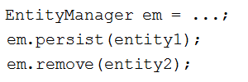
Data Access and Frameworks (cont.)
JPA sample.
Classes that need to be persisted (like Address, Customer, etc) are called entities
In JPA, you insert annotations in an entity class to tell the framework information about reading and writing its data.
An EntityManager is invoked to save entity classes to the database and also to read data from a table into one of the entity classes.
Persisting/Removing | Reading

Slide 6
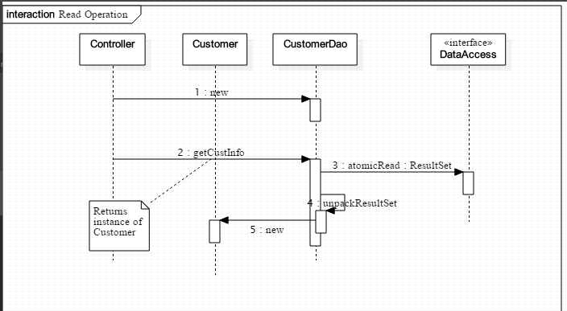
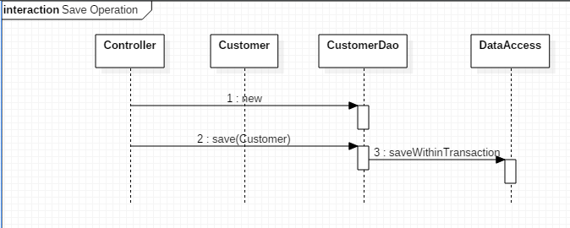
Data Access and Frameworks (cont.)
DAO Sample. In the DAO approach, classes that are persistent (Address, Customer, etc) are associated with corresponding DAO classes, which know how to interact with the data access layer. For instance, a Customer class would be associated with a CustomerDao. Reads and writes of Customer are then facilitated by CustomerDao. See demo: lesson10.lecture.jdbc.framework; your must add dataaccess.jar to the project

